Slide 1
Crafting Compelling Web Presence
Jeya Raman Sekar

Slide 2

BU Soft Tech - Products
https://busofttech.com/
1Core
Fueling Brains
GoMettle
4D CRM
Kabz4kidz

Slide 3
BU Soft Tech - 1Core Solution
1Core is a premier center management software solution tailored specifically for childcare centers in the USA and Canada.
Its specialized SaaS product, complemented by web and mobile apps, offers a comprehensive solution, facilitating seamless tasks from online enrollment to comprehensive monitoring.
With a distinguished history spanning over two decades, 1Core has entrenched itself as an industry stalwart, deeply attuned to the evolving needs and requirements of childcare providers.

Slide 4
BU Soft Tech - 1Core Solution
Renowned for its reliability and efficiency, 1Core boasts a trusted reputation, serving over 500 centers and catering to the needs of more than 1 million children. This widespread adoption is a testament to its effectiveness in enhancing operational efficiency and ensuring the smooth functioning of childcare facilities.
One of 1Core's standout features is its ability to facilitate interaction and communication between childcare centers and parents. Through both web and mobile apps, parents can easily access vital information, receive updates on their child's activities, view schedules, and communicate with staff. This seamless communication fosters trust and transparency between childcare providers and parents, ensuring a positive and collaborative environment for the child's development.

Slide 5
BU Soft Tech - 1Core Solution
Furthermore, the inclusion of mobile apps extends accessibility and convenience, enabling parents to stay connected and engaged with their child's daycare experience while on the go. By providing a platform for real-time updates and communication, 1Core empowers both childcare centers and parents to work together in the best interest of the child's well-being and development.

Slide 6
BU Soft Tech - Fueling Brains
Fueling Brains is a cutting-edge cloud-based solution dedicated to early childhood development and education in the USA and Canada. Their expert team collaborates closely with school districts, empowering educators with innovative teaching methodologies tailored to foster optimal brain development in students.
With a primary focus on enhancing cognitive abilities, Fueling Brains equips teachers with the knowledge and tools necessary to nurture young minds effectively. Through comprehensive assessments and monitoring tools, educators can track and analyze a child's progress, identifying areas for improvement and implementing targeted interventions.

Slide 7
BU Soft Tech - Fueling Brains
Fueling Brains stands out for its commitment to maximizing each child's potential by providing personalized attention and support. By leveraging data-driven insights, educators can adapt their teaching strategies to suit individual learning styles and address specific developmental needs.
Moreover, Fueling Brains emphasizes continuous improvement, offering ongoing training and resources to ensure educators remain up-to-date with the latest research and best practices in early childhood education. This collaborative approach not only benefits students but also empowers teachers to excel in their roles as facilitators of learning and growth.

Slide 8
BU Soft Tech - Fueling Brains
In essence, Fueling Brains serves as a dynamic catalyst for positive educational outcomes, bridging the gap between theory and practice to create enriching experiences that lay a solid foundation for lifelong learning and success.

Slide 9
BU Soft Tech - Go Mettle
GoMettle is a versatile ticketing tool that proves invaluable in software development and sprint management. Offering seamless integration with development workflows, GoMettle facilitates efficient communication and collaboration among team members during the entire development lifecycle.
In development, GoMettle serves as a centralized hub for managing tasks, bugs, and feature requests. Teams can easily create and prioritize tickets, assign them to specific team members, and track their progress in real-time. This ensures transparency and accountability, enabling teams to stay organized and focused on delivering high-quality software within deadlines.

Slide 10
BU Soft Tech - Go Mettle
During sprint planning and execution, GoMettle enhances agility by providing a clear overview of sprint goals, tasks, and priorities. Teams can break down user stories into actionable tasks, estimate effort, and allocate resources effectively. With features like customizable workflows. GoMettle empowers teams to visualize their work, identify bottlenecks, and adapt quickly to changing requirements.
Moreover, GoMettle's reporting and analytics capabilities offer valuable insights into sprint performance, allowing teams to identify areas for improvement and optimize their processes over time. By streamlining development and sprint management, GoMettle enables teams to deliver software faster, with greater efficiency and quality.

Slide 11
BU Soft Tech - Go Mettle
GoMettle stands as a versatile solution suitable for various industries and business sizes, offering scalability and flexibility to adapt to evolving needs. Whether it's IT support, customer service, or project management, GoMettle empowers organizations to deliver exceptional results through efficient ticket management processes.

Slide 12
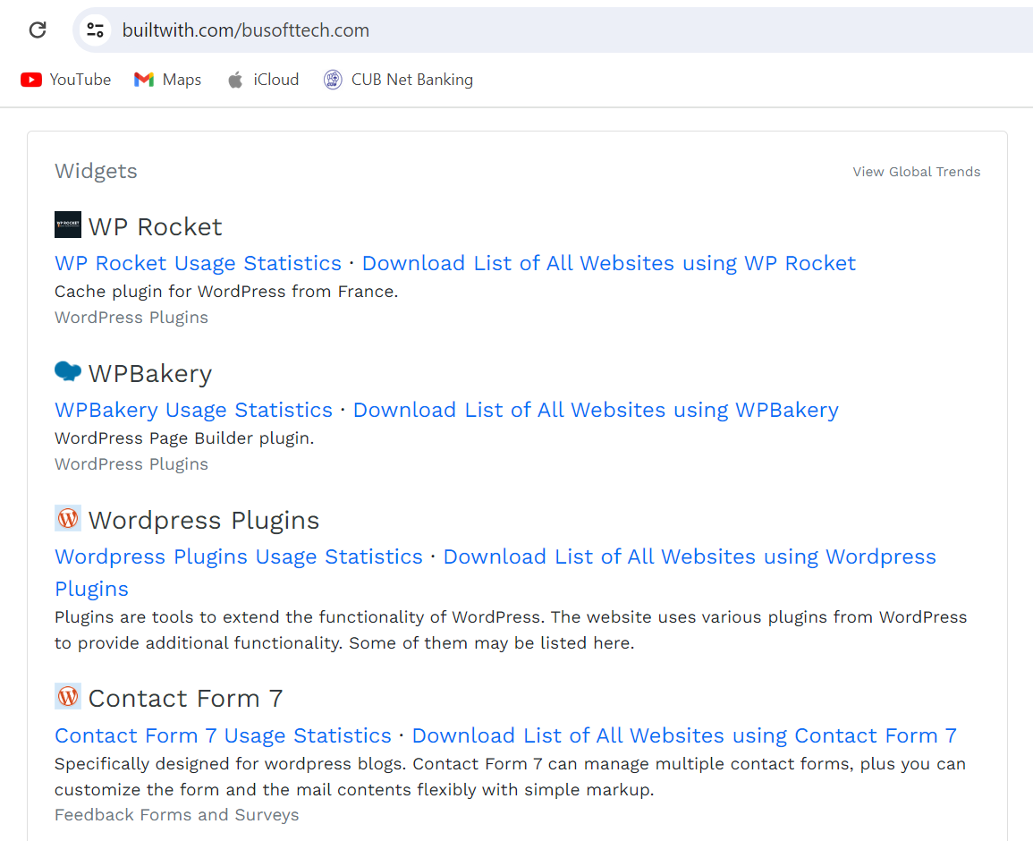
aa
BU Soft Tech – Website Analysis
CMS – WordPress
Hosting – Amazon SES
Server – Go Daddy
CDN - jetpack
Web Master – Google
Web Server – Nginx
Web Hosting – Unified Layers

Slide 13
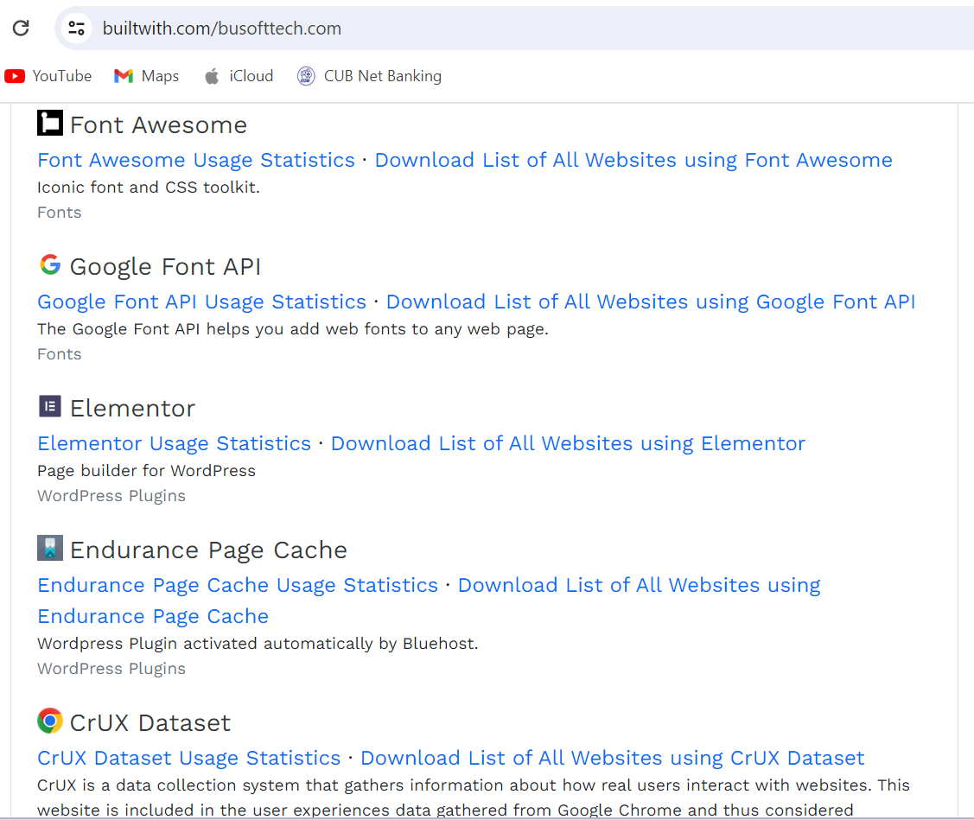
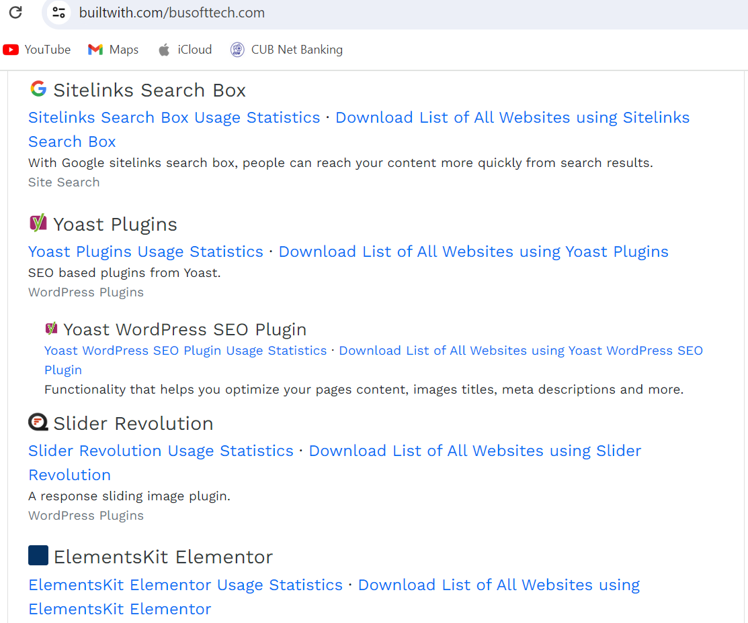
BU Soft Tech – Website Analysis

Slide 14
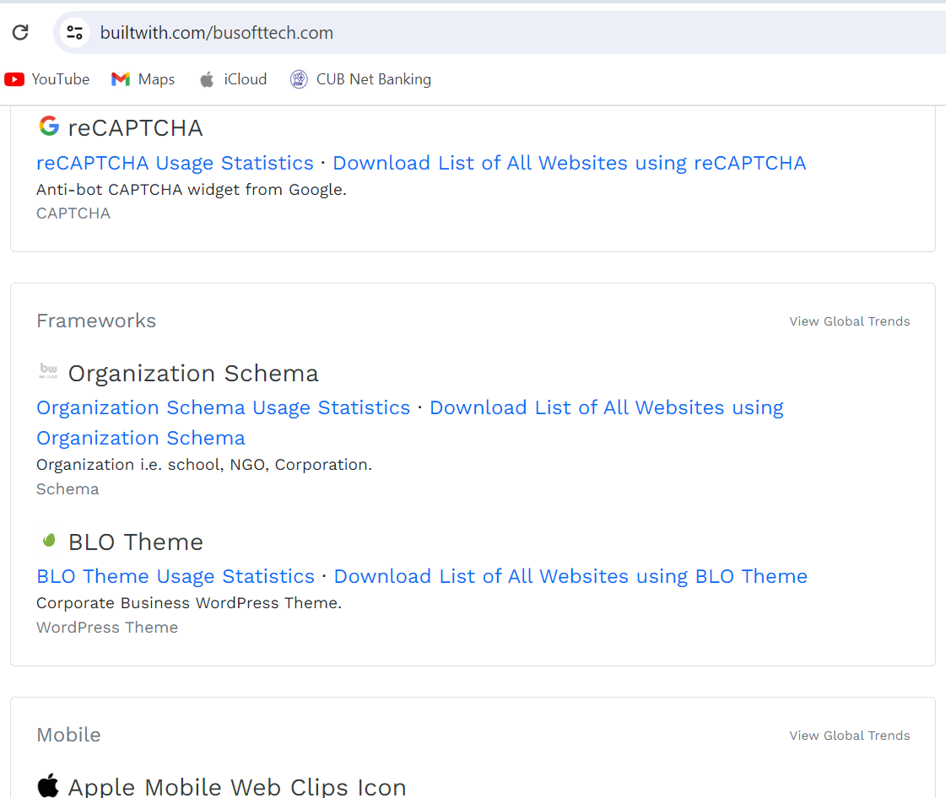
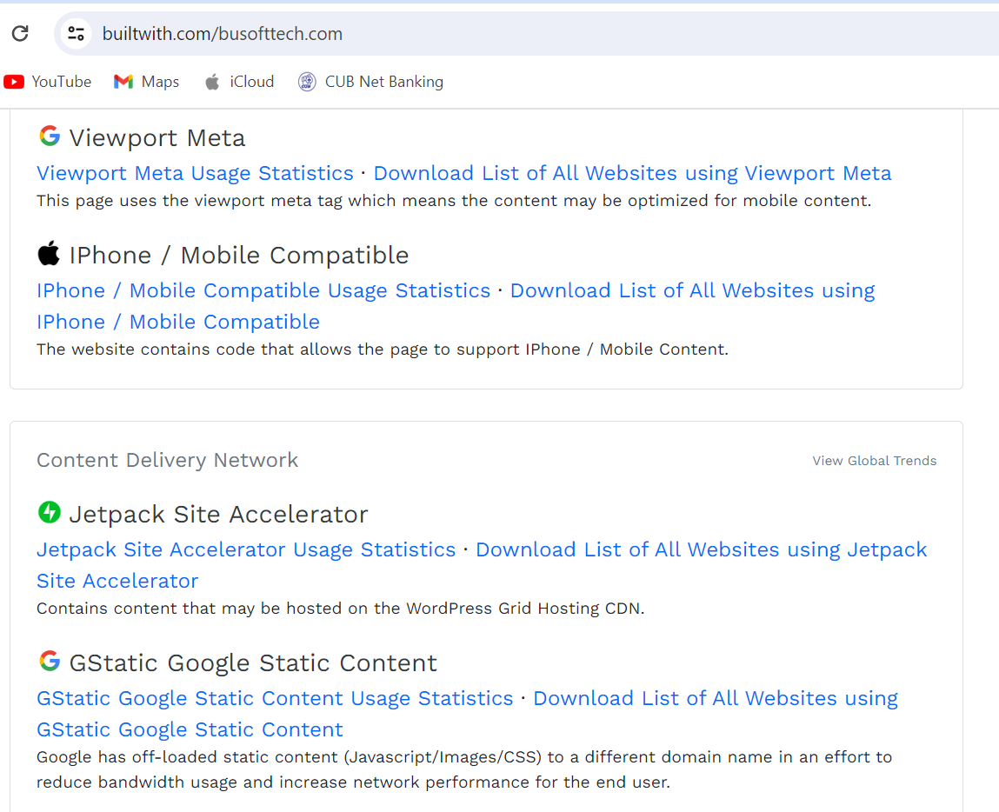
BU Soft Tech – Website Analysis

Slide 15
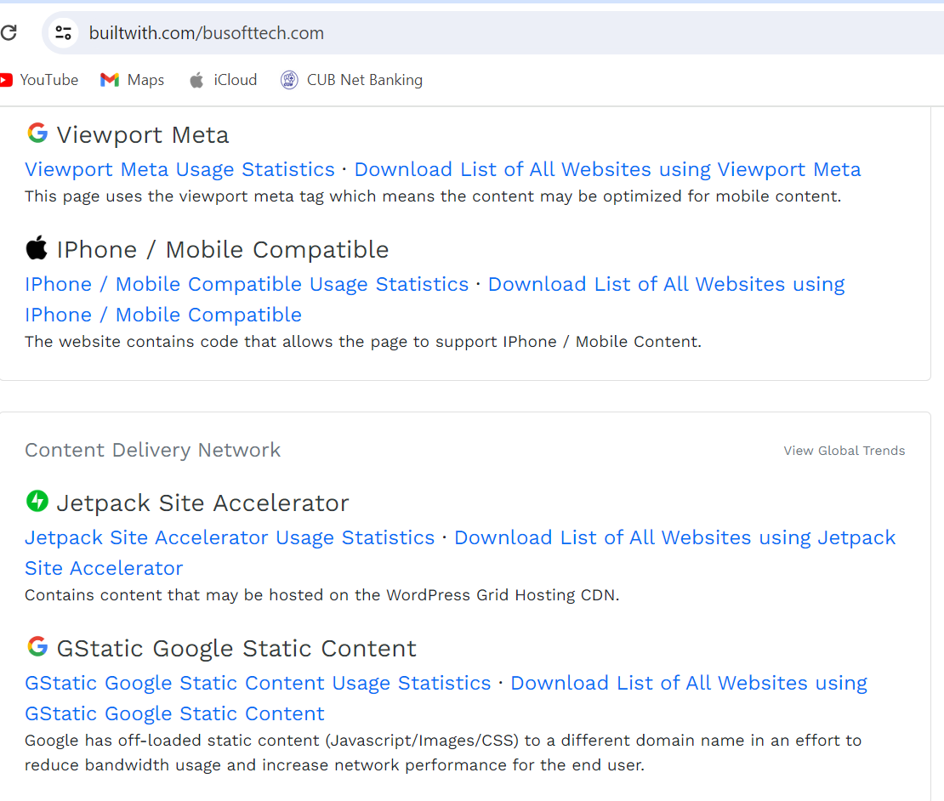
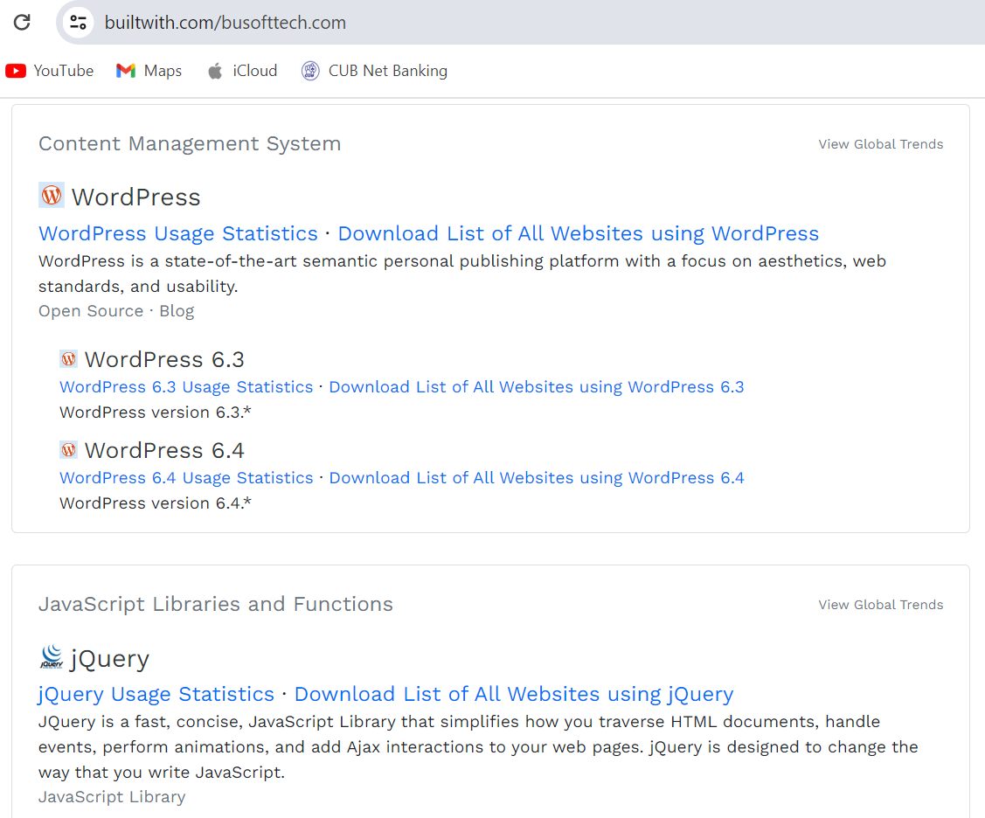
BU Soft Tech – Website Analysis

Slide 16
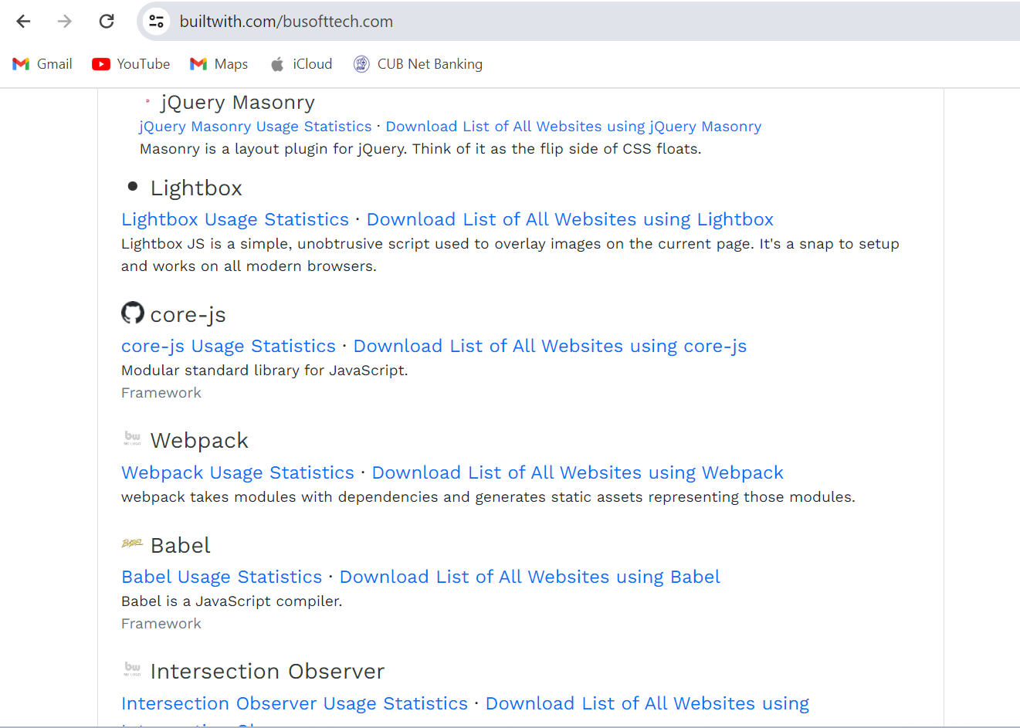
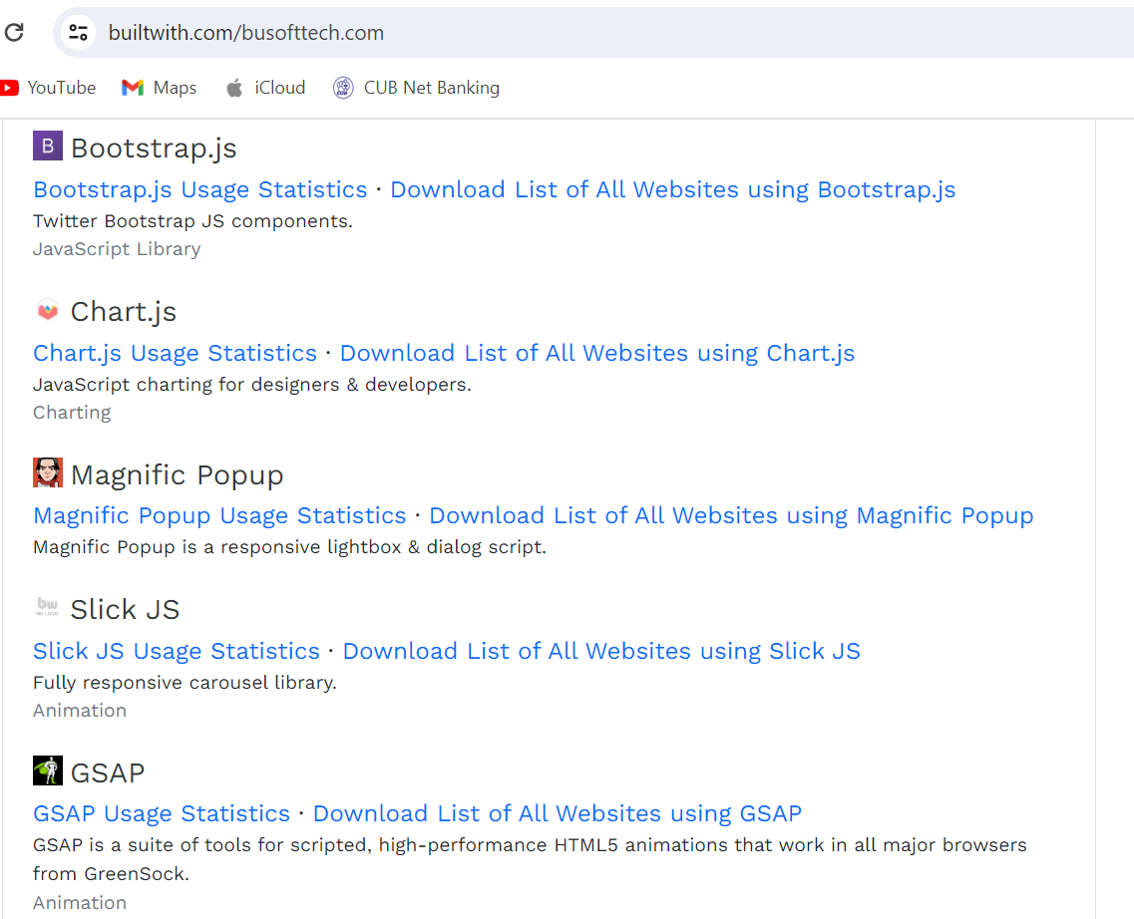
BU Soft Tech – Website Analysis

Slide 17
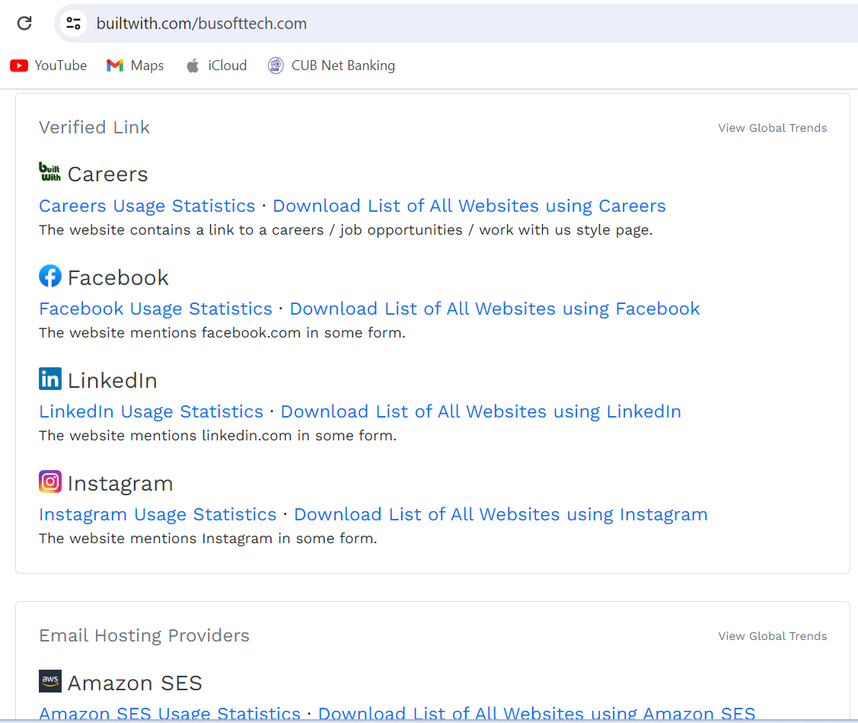
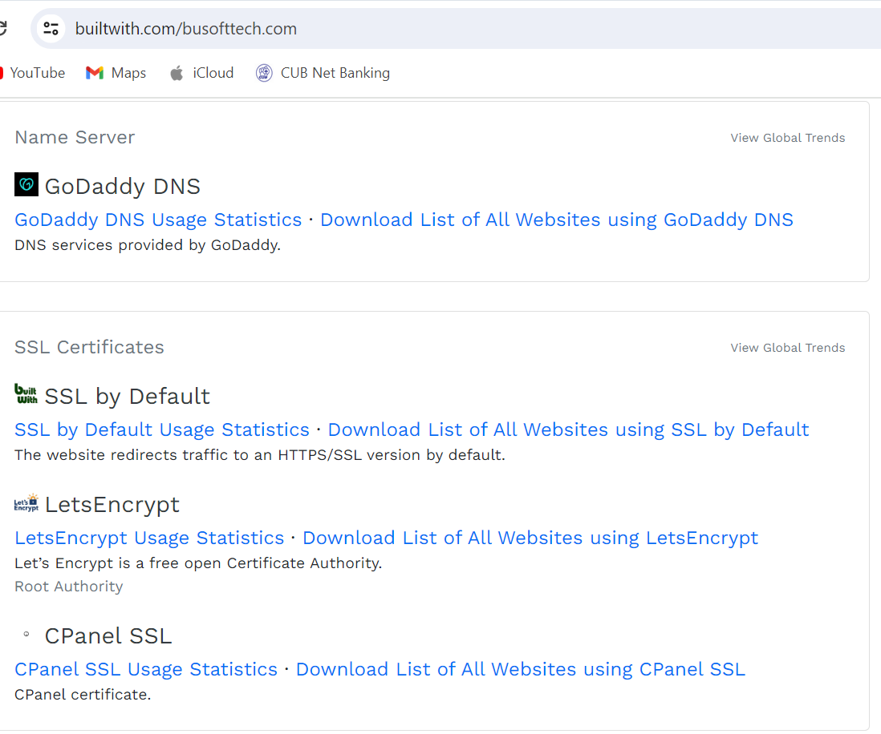
BU Soft Tech – Website Analysis

Slide 18
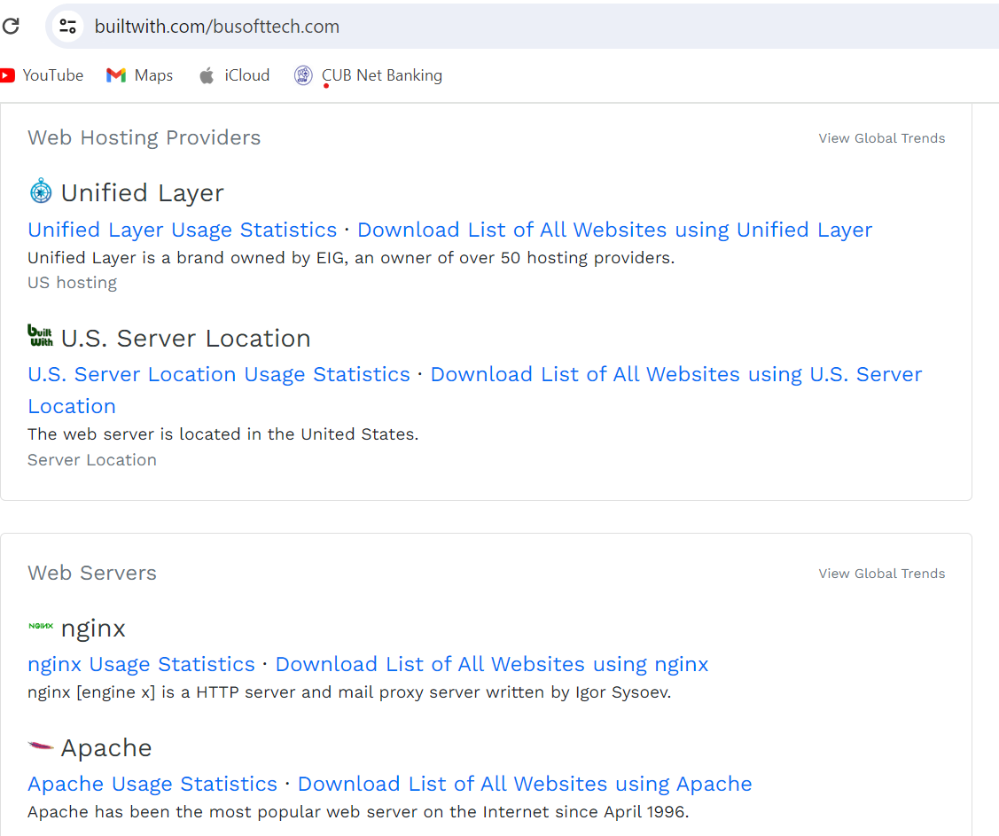
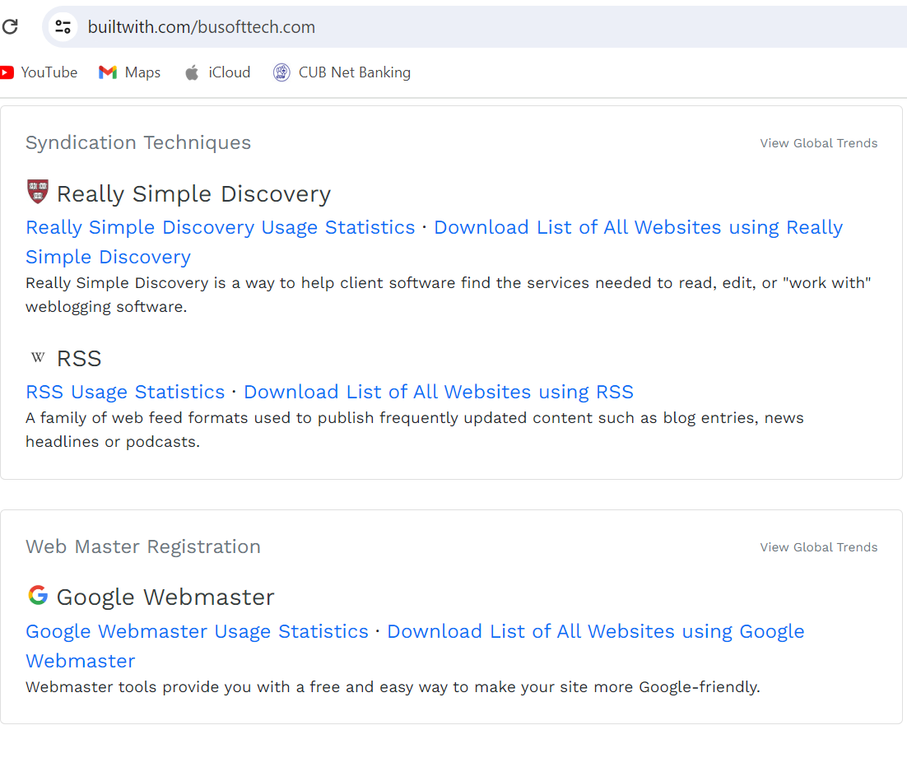
BU Soft Tech – Website Analysis

Slide 19
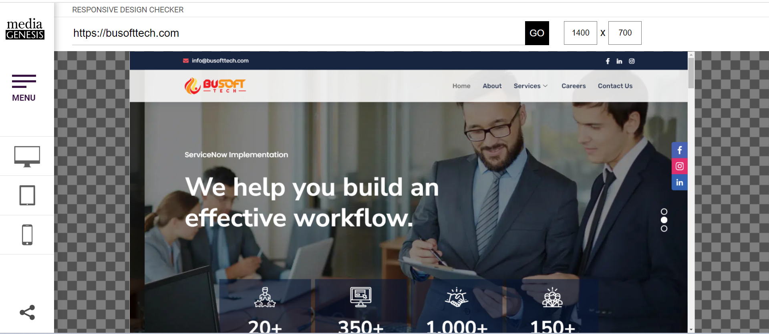
aa
BU Soft Tech – Responsive Design Reports
Home Page

Slide 20
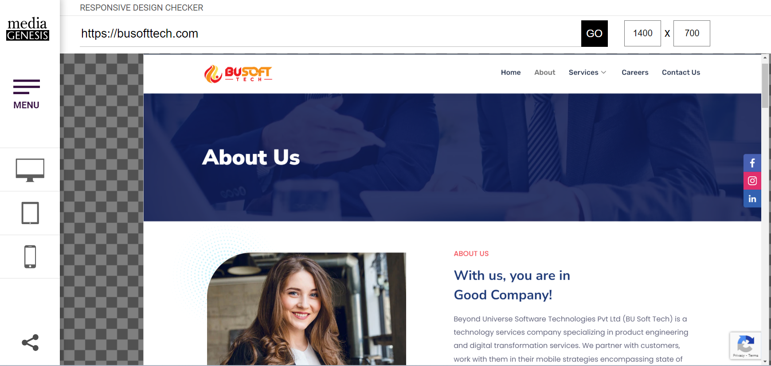
BU Soft Tech – Responsive Design Reports
About Us Page

Slide 21
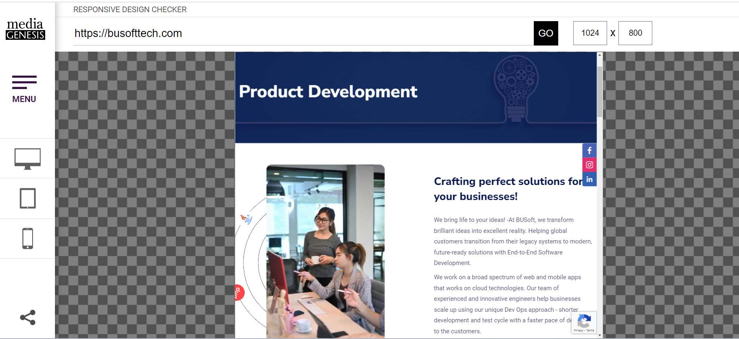
BU Soft Tech – Responsive Design Reports
Product Development Page

Slide 22
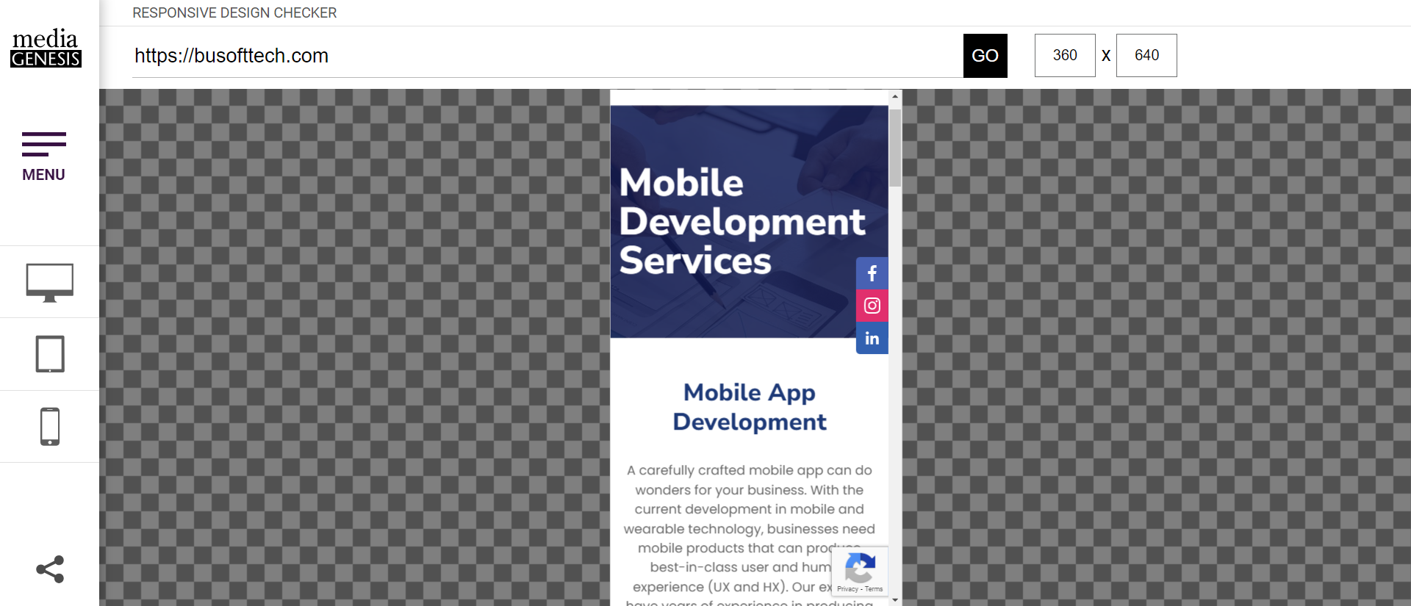
BU Soft Tech – Responsive Design Reports
Mobile Development Page

Slide 23
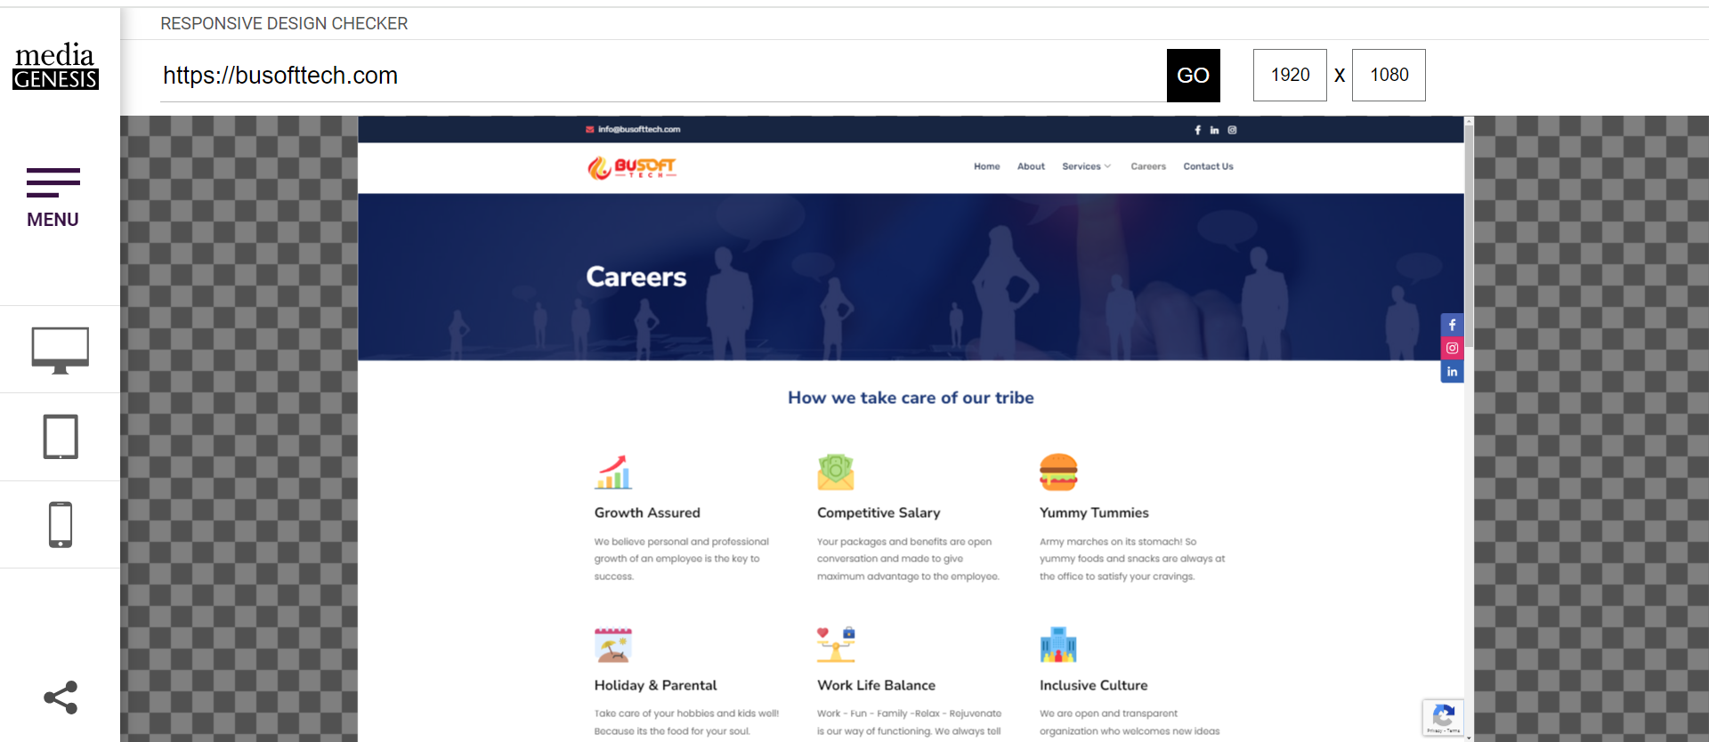
BU Soft Tech – Responsive Design Reports
Careers Page

Slide 24
BU Soft Tech Website Suggestions
Loading Time
Too Much of Plugin Dependency
Use of More Stock Images instead of Real
Very little showcase of their Products
No Social Proof/ Reviews/ Accreditation
Mission/vision repeated in Home and About Us Page

Slide 25
BU Soft Tech Good Practices
Simple and Neat
Less Content and easy to read
User- Friendly

Slide 26
BU Soft Tech – 1Core Landing Page
https://sekanaman.wixstudio.io/busofttech-1core

